Slide 1
Reminder:

Slide 2
Robo-AO at South Pole Station
Tony Travouillon
Thirty Meter Telescope / Caltech
Richard Dekany
Associate Director for Instrumentation Development, COO
Principal Investigator, PALM-3000 Adaptive Optics System
Christoph Baranec
Principal Investigator, Robo-AO
California Institute of Technology
25 March 2011

Slide 3
Why NIR astronomy in Antarctica?
Advantages
Low near-infrared background, K ~ 17 arcsec⁻²
B ~ 40x smaller than Mauna Kea
Faint sources (compact or extended)
Particularly attractive at the telescope diffraction limit
Sites of superb image quality above boundary layer
Dome C median seeing ~0.27” FWHM at 0.5 μm (Lawrence et al., 2004)
Long nights
Flexible observing cadence
Fast transient events (Law, Kulkarni, Dekany, et al., 2009)
Precision radial velocimetry of late-type stars (Seifarht and Kaufl, 2008)
Challenges
Need logistics and infrastructure
Need technology validation, experience, confidence
2m class telescope operation
Adaptive optics instrumentation
Solution
Commit to an incremental program to establish a US optical / NIR astronomy presence in Antarctica
Begin at the South Pole
“Not enough has been done in the NIR and that’s a tragedy”
– M. Burton, a few hours ago…

Slide 4
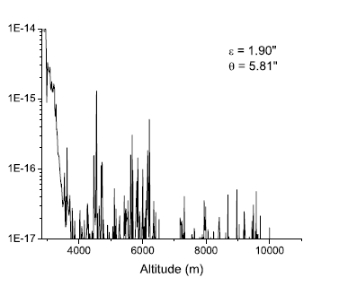
GLAO at SP?

Slide 5
What is Robo-AO?
Robo-AO (C. Baranec, Caltech, PI)
“A robotic laser guide star adaptive optics system”
A new paradigm of automated observing
Based on 11 years operation of Palomar 5m telescope AO and robotic operation of Palomar Transient Factory (PTF)
A demonstration collaboration between Caltech and IUCAA (India)
 | Traditional Laser Guide Star Adaptive Optics | Robo-AO Robotic Laser Guide Star AO
Telescope diameter | 3-10m | 1.5-3m
Lock-on time | 5-15 min / target | 0.5-1 min / target
Targets per night | Tens | Hundreds
Program Length | Few nights | Weeks+
Targets per program | ~100 | Thousands
Personnel | 1 astronomer + 6 spotters + 2 telescope control | 1 astronomer (peacefully sleeping) [Or on-site but rarely attending]

Slide 6
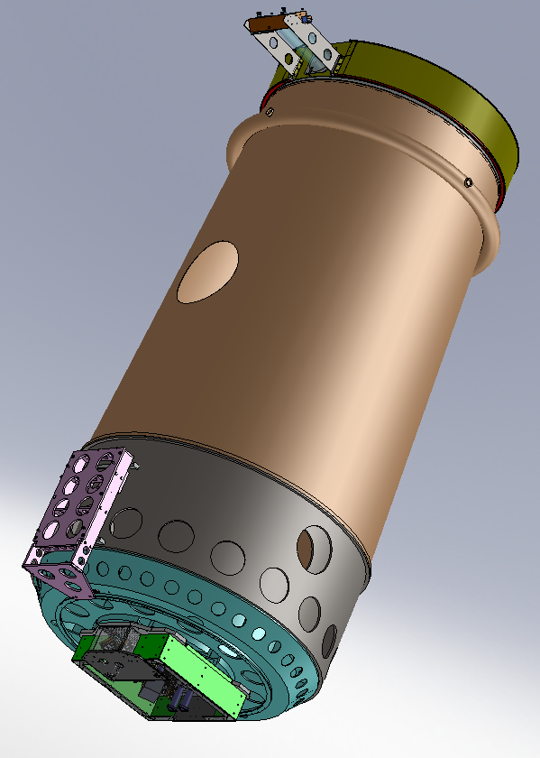
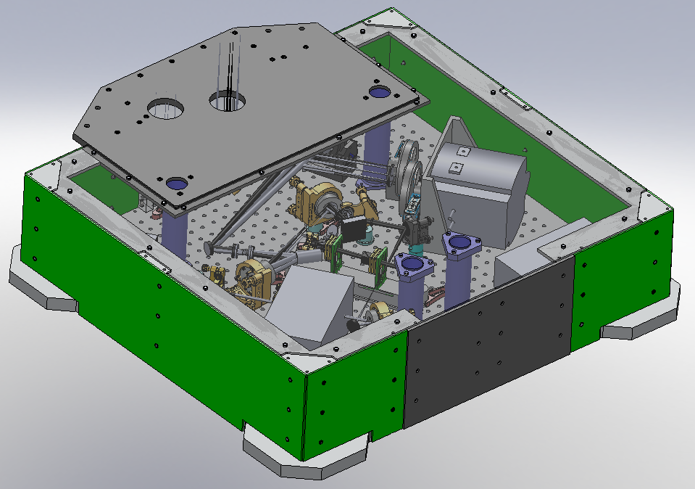
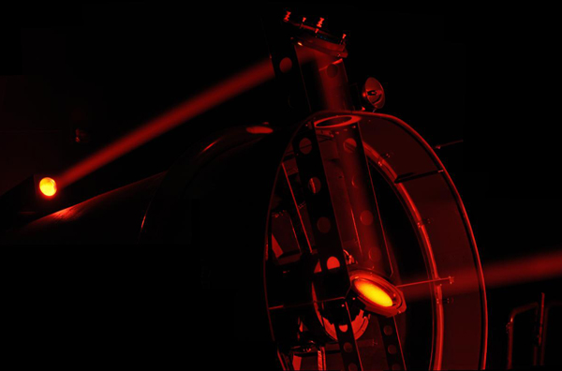
Robo-AO: Projector & Cass Instrument

Slide 7
Robo-AO at SP Capabilities
Current Robo-AO operational modes at Palomar
Diffraction-limited over 1’ – 2’ using mV < 18 tip-tilt guide star
~0.1” in the visible
~0.2” in the near-infrared
K-band Strehl ratio > 0.8 over 30% sky
Seeing improvement over the entire sky without tip-tilt star
~0.3” in visible or near-infrared
Or diffraction-limited with short exposure L3CCD camera in visible
Design optimization for SP
Ground-layer AO (GLAO) deformable mirror conjugation to ~200m altitude (Travouillon et al., 2009)
Increase DM actuator count to correct poor boundary layer
Use higher power DPSS laser at 532 nm
Consider 2x2 mosaic H2RG camera for ~ 7’ FoV

Slide 8
Why start Robo-AO at SP?
Advantages
Robotic: High efficiency observing; Large diffraction-limited observing programs
Adaptive optics: High angular resolution
High sensitivity, low confusion
Small spectrographs match to diffraction limit
Laser guide star: High sky coverage
Rayleigh LGS
Particularly well suited for correction of thin boundary layer
Commercial, affordable, high power lasers
Low-cost
Hardware ‘replication cost’ of Palomar system < $500K (not winterized)
With dedicated H2RG imaging camera ~$1M (not winterized)
Maturity
Developed and to be demonstrated at Palomar Observatory in 2011-12
Expected performance of Robo-AO clone at SP ~180 nm equivalent RMS WFE for > 80% K-band Strehl
Supported by detailed error budget validated at Palomar and Keck
SP system would be reoptimized to better balance terms
Current goal is weeks of unattended operation – no reason not to obtain months
Data quality monitors and pipelines to be developed for Palomar demonstration
Challenges
South Pole 2m-class robotic O/IR telescope
Winterizing for SP
Power requirement – several kW draw, but a LGS power a tradable design parameter
Installation and human safety – particularly with green LGS option

Slide 9
SP 2m AO equiv to Mauna Kea 5m with AO in point source sensitivity
SNR ∝ (SτqF₀D²) / sqrt(SτqF₀D² + τqBackground)
For background limited observations, combination of AO and low K-band background makes 2m SP telescope highly competitive for NIR observations
 | D [m] | Image Size | Strehl, S | τq (trans*QE) | K-band Lim mag (5σ, 1 hr)
Gemini N | 8.4 | 0.7” | 1 | 0.79 | 22.1
Gemini N w/ AO (ALTAIR) | 8.4 | 0.054” | 0.5 | 0.62 | 24.3 (on axis)
SP | 2 | 1.8” | 1 | 0.79 | 21.5
SP w/ AO | 2 | 0.23” | 0.5 | 0.62 | 23.4 (averaged over 3.5’) Equiv to 5m AO telescope on Mauna Kea

Slide 10
Robo-AO science programs executable in 3-year SP program
High-contrast surveys
IR excess targets as debris disk candidates
A new view of planetary system formation via direct dynamical studies
Astrometric planet searches
Companions to M dwarfs, T dwarfs
1000’s of potential substellar companions to complete low-end of the initial mass function
Rapid transient characterization
SNe classification
Microlensing events
Precursor demonstration for ultimate LSST coordination
Large imaging surveys
Interacting galaxies, star formation
1000’s of new lensed quasars
Astrometric surveys
IMBH’s in globular clusters
… and others

Slide 11
Microlensing
OGLA and MOA alert over 1,000 new microlensing events each year primarily during the bulge season (May-September)
12 Exoplanets have been discovered this way
Better time coverage is needed
Benefits from high resolution to reduce blending of background sources
Does not need very wide field of view (<10’)

Slide 12
Robo-AO at SP an essential step to a wide-field NIR presence on at a plateau site
Proven technology transportable across the Continent
2-3 winter demonstration of Robo-AO at SP key to technology validation
Commercial lasers, deformable mirrors, electronics, mechanisms (drives, etc.)
2nd generation Robo-AO to have wider field correction
Dome C, e.g., has even thinner boundary layer and larger isoplanatic angle (NGS?)
Robo-AO DM technology reconfigurable for wider FoV correction
Additional of 2nd DM can open available diffraction-limited field for successive telescopes
Terminology: Multi-Conjugate Ground-Layer AO (MCGLAO) (Dekany et al, in preparation)
Mosaic detector array provides large, sensitive complement to JWST in 2020 time frame

Slide 13
The field of view increases at Dome C

Slide 14
DC 2m MCGLAO order of magnitude better than VISTA 4m for NIR survey speed
Survey Speed ∝ SNR² * θ₀²
60x shorter SP MCAO frame integration time avoids pixel saturation, nonlinearities, cosmic rays, and allows dithering for background subtraction
 | K-band Strehl, S | SNR (K=22, 1 hr) | Field of View | Survey Speed (relative)
VISTA 4m SL 16 VIRGO 2kx2k @ 340 mas/pix | 1 | 2.3 | 0.77 deg | 1
Cerro Pachon 8m MCAO “GeMS” 4 H2RG 2kx2k @ 20 mas/pix | 0.4 (avg over 85”) | 27.8 | 0.024 deg | 0.14
SP 2m AO (1st generation) 1 H2RG 2kx2k @100 mas/pix | 0.6 (avg over 3.5’) | 17.3 | 0.057 deg | 0.31
Plateau site 2m MCGLAO (2nd generation) 25 H2RG 2kx2k @150 mas/pix | 0.4 (avg over 30’) | 13.4 | 0.43 deg | 10.4

Slide 15
The wider field correction allows…
Transit search in young stellar clusters (early planet formation and frequencies of planets in cluster environment)
Does not have the restrictions of Keppler (Faint stars and northern sky)
Antarctica has a much better window function than SuperWASP and HATNet which lead to better parameter space and resolution of eclipsing binaries contaminations (Braun et al. 2009)

Slide 16
Robo-AO acknowledgements
Partially funded by the National Science Foundation.
http://www.astro.caltech.edu/Robo-AO/

Slide 17
References
N. Law, S. Kulkarni, R. Dekany, et al.,“The Palomar Transient Factory: System Overview, Performance, and First Results”, PASP 121 1395L, 2009.
Seifahrt and Käufl, “High precision radial velocity measurements in the infrared - A first assessment of the RV stability of CRIRES”, A&A 491 (3) 929-939 (2008)
T. Travouillon, L. Jolissaint, M. C. B. Ashley, J. S. Lawrence, and J. W. V. Storey, “Overcoming the Boundary Layer Turbulence at Dome C: Ground-Layer Adaptive Optics versus Tower,” PASP, 121:668-679, 2009 June.

Slide 18
Backup Slides

Slide 19
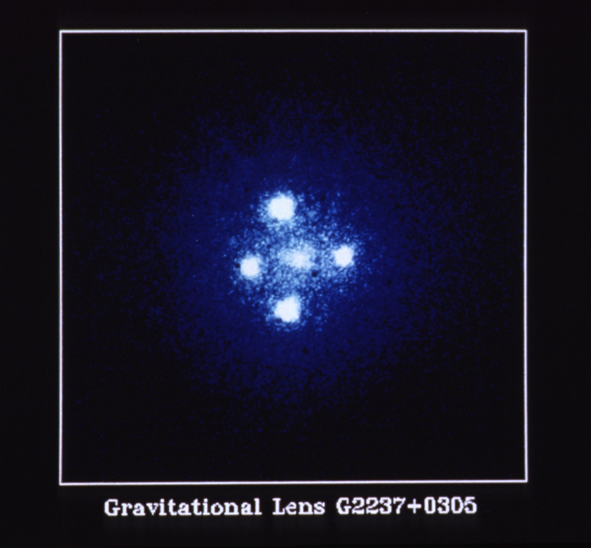
Robo-AO Survey Programs - Lensed Quasars
By observing lensed quasars, we can model the mass distribution within a galaxy: tells us about the dark matter distribution
Currently there are ~100 known lenses, and 10,000++ known candidates
Using Robo-AO and a few months of observing we can expand the number of known lenses by factor of 10 or more
Follow up for time delays / dynamics
Einstein Cross (HST)
(1.6 arc sec top to bottom)

Slide 20
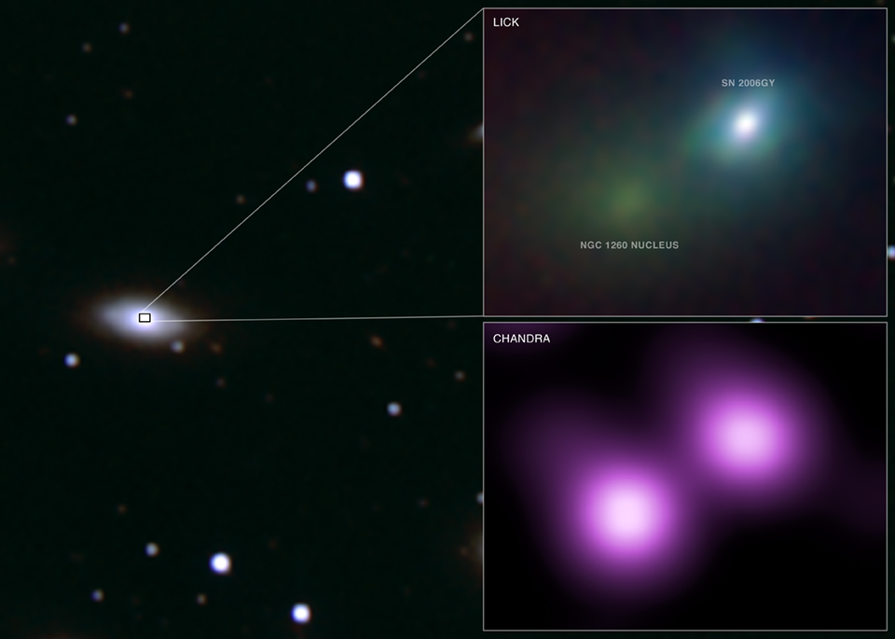
2006GY
Optical Transient resolved with Lick AO system

Slide 21
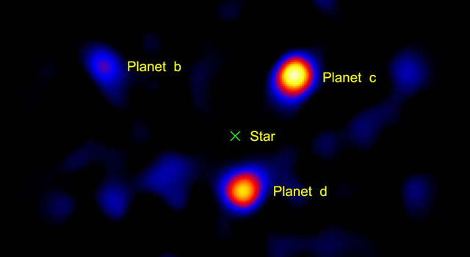
Palomar test demonstrates very high contrast possible with 2m-class telescope
3 planets around HR 8799
Image taken with 1.5m portion of P200 w. PALMAO
Vortex coronagraph for high-contrast imaging
Serabyn et al. Nature 2010

Slide 22
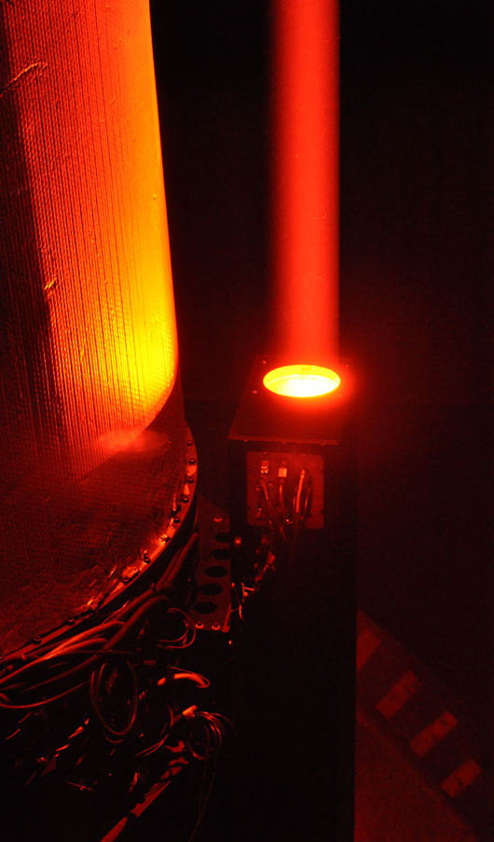
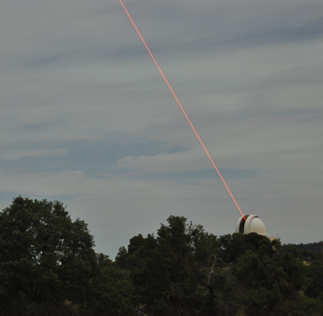
UV Laser at the P60

Slide 23
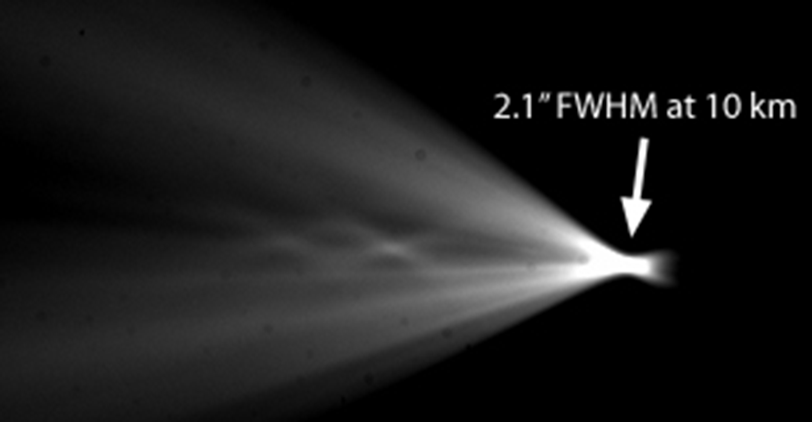
UV Laser at the P60

Slide 24
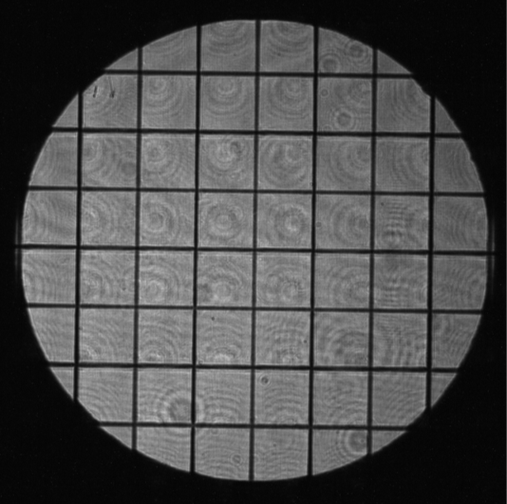
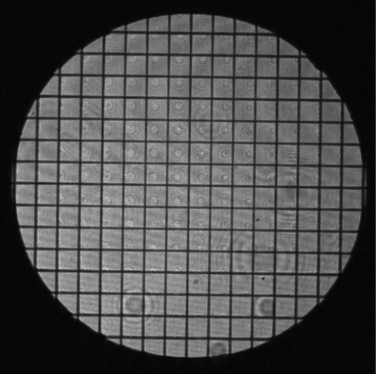
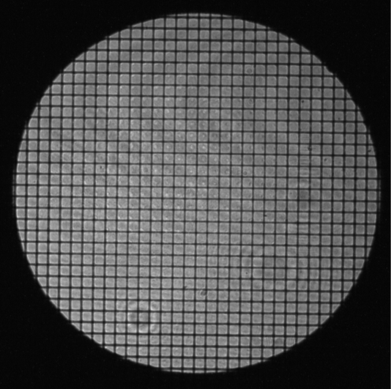
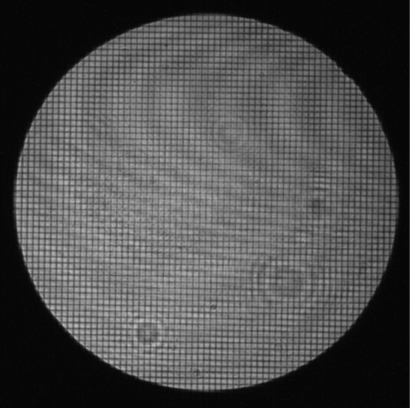
PALM-3000 Shack-Hartmann WFS reusable for NPX 2m AO with N = 64 subapertures across pupil
Microlens arrays imaged with a CMOS alignment camera
Shack-Hartmann spots imaged with the CCD-50
NPX 2m Robo-AO sampling

